Slide 1

High-Speed Real-Time VIDEO Streaming
Maksym Holub
Oleh Kuzhylnyi
Oleksandr Ostrianko
Scientific Advisor: Tymofii Khodniev
Department of Design of Electronic Digital Equipment (DEDEC dept.),
Faculty of Electronics, National Technical University of Ukraine "Igor Sikorsky Kyiv Polytechnic Institute“, Kyiv, Ukraine
NTUU KPI

Slide 2
Objectives
Create a custom FPGA-based design with MIPI CSI-2 interface for the development board.
Build a custom Linux distribution based on ARM-part of Xilinx SoC;
Test the connection between Linux distribution and camera;
Include into distribution ARAVIS library and other necessary dependencies;
Build and test a software module on the development board for transmitting a videostream;
Launch the prepared software module on the Zybo Z7-10 board.
Transmit the output videostream with FullHD resolution from the camera to the PC via Cat-5e cable;
Connect Cat-5e cable to LAN port and check the output flow in ARAVIS viewer

Slide 3
Streaming Technology comparison
Nowadays there exists a large number of competitive video streaming technologies: those based on RTSP, GigE Vision, USB3, and others.The vast majority of them rely on complex interoperated use of multiple protocols at once.
The vast majority of them rely on complex interoperated use of multiple protocols at once, leading to:
overgeneralized specifications having “weak definitions”, thus allowing for numerous different concrete implementations (one may see it as a way to make the streaming technology perform its best in all possible use cases);
excessively high complexity of a purely theoretical analysis of streaming technology characteristics.

Slide 4
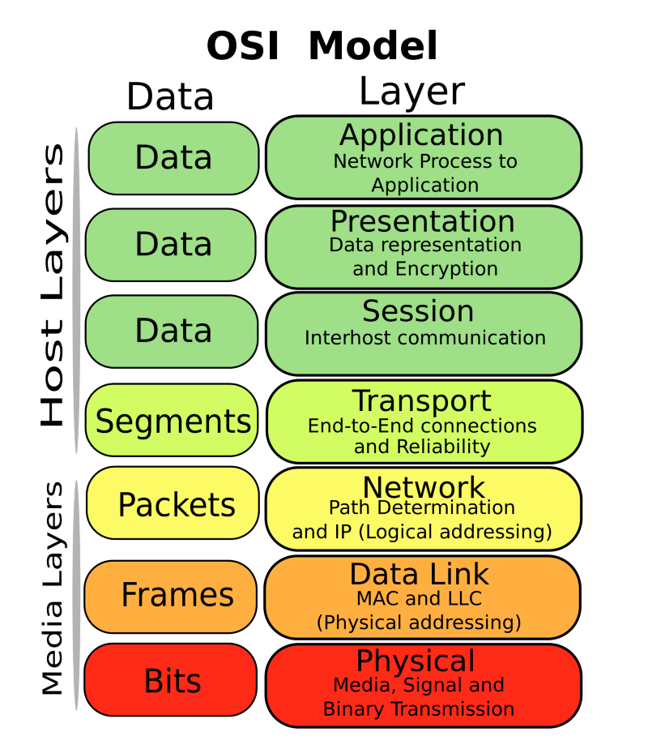
RTSP-based streaming - stack
GenICam API
GigE Vision stack
Streaming server/client
GigE app
RTP
strea-ming
RTSP
GVCP
(control)
GVSP
(streaming)
HTTP (extended) transport
UDP
UDP
TCP/UDP/SCTP/DCCP/…
RTCP
TCP/…
IP
IP
…
…
IP/…
Ethernet
Ethernet
…
…
…

Slide 5
Drawbacks of exiting streaming technologies
USB3 cameras transmit flow to nearest host and do not able to communicate via network layers
RTSP-technology not so much strict in real-time video transmitting unlike GigE vision and uses bandwidth less efficiency and it is an weakly detemined than GigE vision
The RTSP is less predictable in traffic generation sence as shown below

Slide 6
Design Approach altogether
Our solution of buffering delay is relying on a custom flexible realization of MIPI receiver module (MIPI subsystem IP-Core) and using high efficiency ARM+FPGA Soc Zynq-7000
Instead of acquiring and buffering the whole video frame before the transmission, it uses buffering only for parts of the frame, allows into reducing the delay

Slide 7
MIPI Receive Subsystem
The MIPI CSI-2 RX IP-core subsystem is the main component for creating systems based on the MIPI protocol
D-PHY RX interface is implemented via MIPI D-PHY IP-core and provides PHY protocol layer which compatible with the CSI-2 RX interface
The MIPI CSI-2 RX Controller core receives 8-bit data per line involves support for up to 4 lanes
The final extracted image is made available to the user/processor interface using the AXI4-Stream protocol

Slide 8
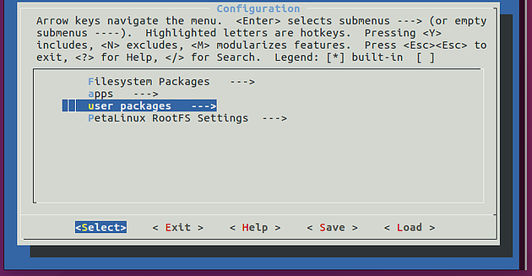
Embedded Linux Design
Embedded Linux has been installed on top of the ARM core part of the Xilinx SoC
Finite Linux distribution is based on the Xilinx PetaLinux Project which involves Yocto and PetaLinux tools for assembly required packages
Zybo Z7-20 base-Linux project from Digilent had been ported for our board that in result became a heard of the PetaLinux Project

Slide 9
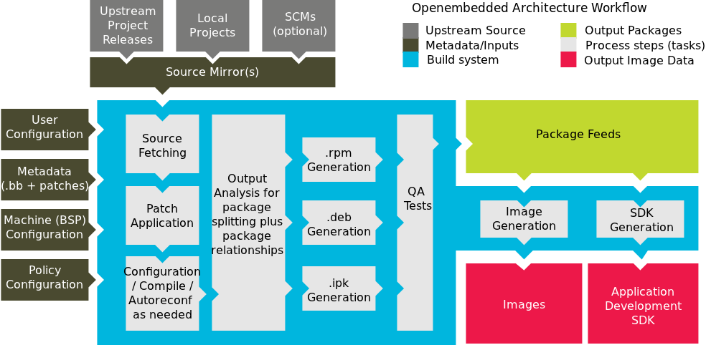

Slide 10
Alternatives to embedded Linux?
— I’d like a kilo of that sour lemons, please.
BSD-like kernels: FreeBSD, DragonFly BSD, NetBSD.
BSD kernels are extremely stable, safe and good at I/O-bound tasks, especially in the networking. The FreeBSD also includes stuff like jail and a Linux compatibility layer, which may come in handy for your project. BSD kernels are also widely adopted by serious players in industry (Sony Playstation OS and Juniper JunOS are both derived from the FreeBSD)
QNX and VxWorks.
These solutions allow to meet the real-time requirements while keeping the kernel as close to Linux as possible. The QNX kernel runs the Linux kernel as a separate task, which means you’ll end up rewriting all the drivers requiring the real-time for QNX. These two solutions are also proprietary.

Slide 11
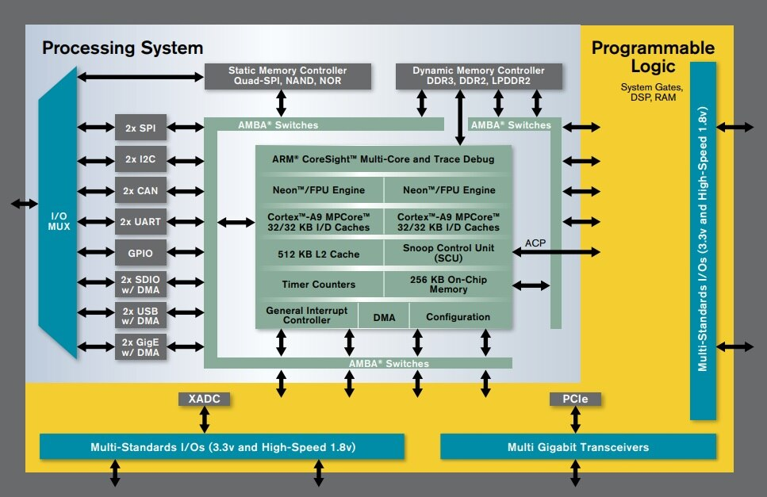
Perspectives for FPGA/SoC designs
SoC FPGAs contain an ARM core, a set of basic primitives and a FPGA matric for implementing the custom peripherals.
Given that a lot of configurable IP cores exist and are well coupled with the Linux kernel tools, it allows for very robust flexible designs
Xilinx Zynq-7000 architecture

Slide 12
Demo

Slide 13
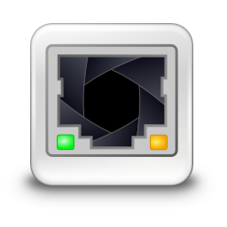
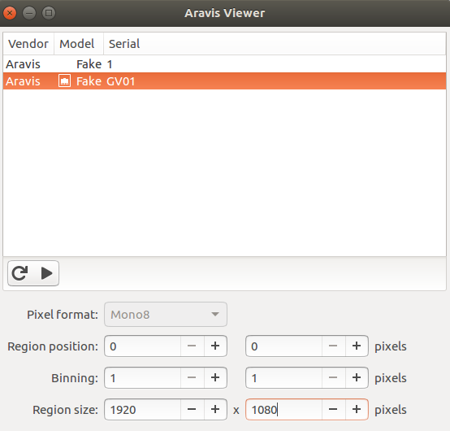
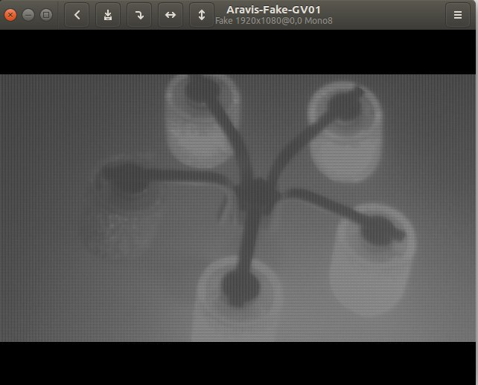
Software design
The GigE Vision standard is proprietary and requires licensing. In spite of this, there exists an open-source ARAVIS library, implementing the GigE Vision interface based on results of reverse engineering of the corresponding protocols
In our implementation the ARAVIS library is used for designing a GigE vision standard compatible camera
For realizing a capture frames from a camera we wrote a C program module which uses Video4Linux and ARAVIS API
The ARAVIS viewer is used for view an output video flow

Slide 14
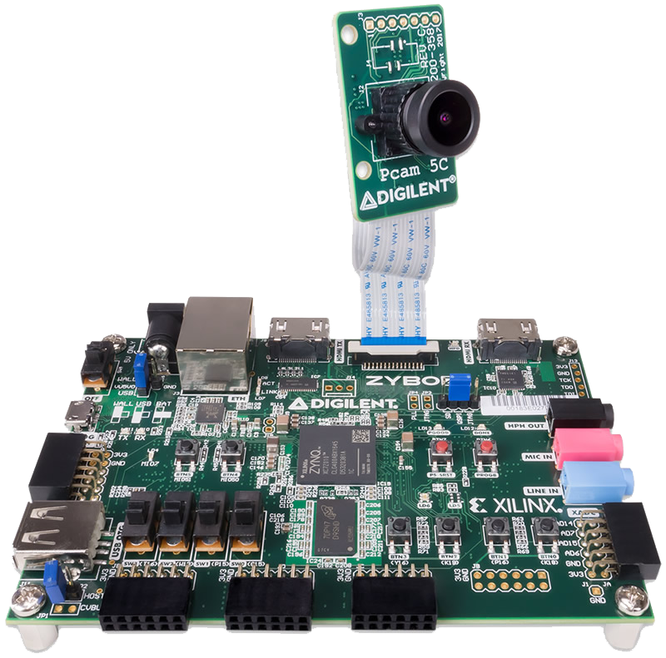
Summary of the design project
The design is complete, meets its objectives and in addition no analogue in the world
The design has a modular approach and every component has a specific function
For project future improving is possible to change the main camera to any another powerful PHY-camera or vice versa use USB camera
Required tools:
ZyboZ7-10 (Zynq-7000 ARM/FPGA SoC Development Board)
Digilent Pcam 5C and ribbon cable for communication
Micro USB cable
Power supply 5V/2A
Cat-5e cable
microSD card

